Slide 1
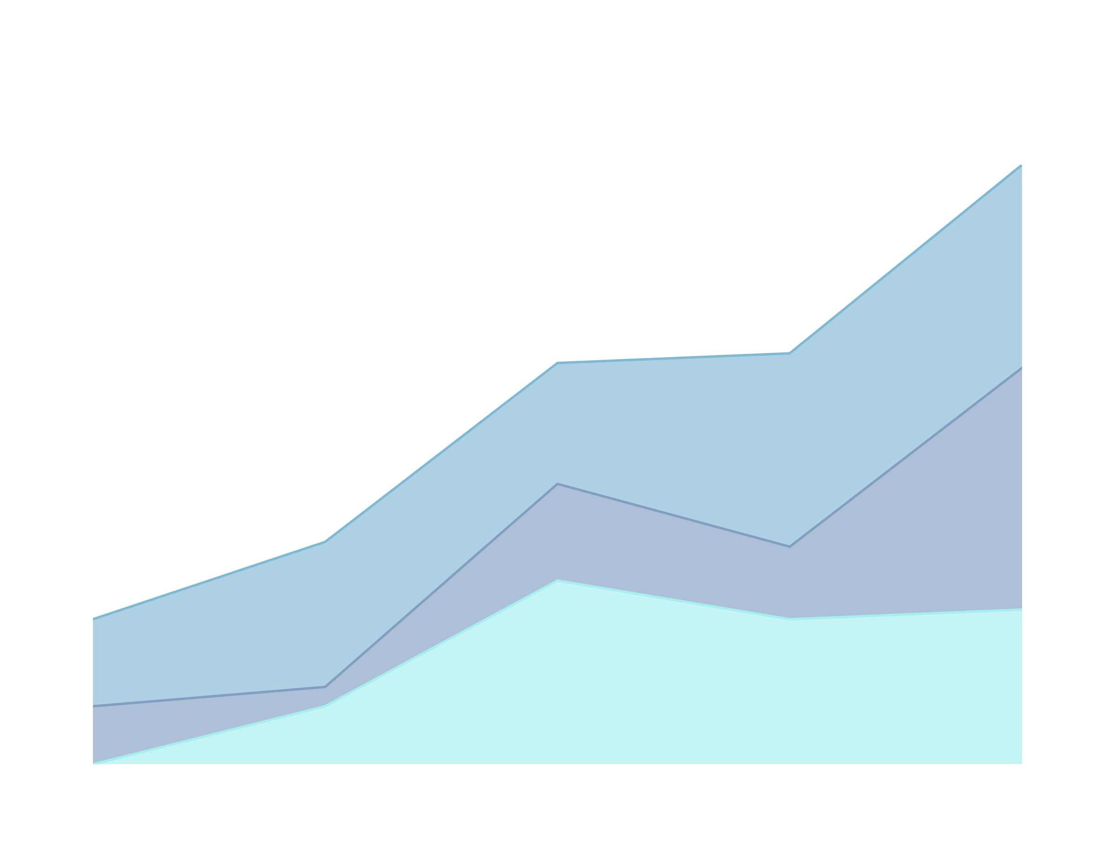

JOB ATTRITION
By: Megan Huy, MSDS Student at Southern Methodist University

Slide 2

Objective
To provide insights on employee resignation or leave from the company to support stakeholder decision-making and company’s growth.

Slide 3
Why Look at Employee Attrition?
The analysis allows our stakeholders to find meaningful insight of attrition within the company.
Prevent loss
Enhance employee satisfaction
Support employee growth
Prevent burnout
Reduce the cost and time commitment to train new hires.

Slide 4
Data Description
The data set is from the company’s record.
There are 870 employees and 36 variables.
The report shows no missing information.

Slide 5
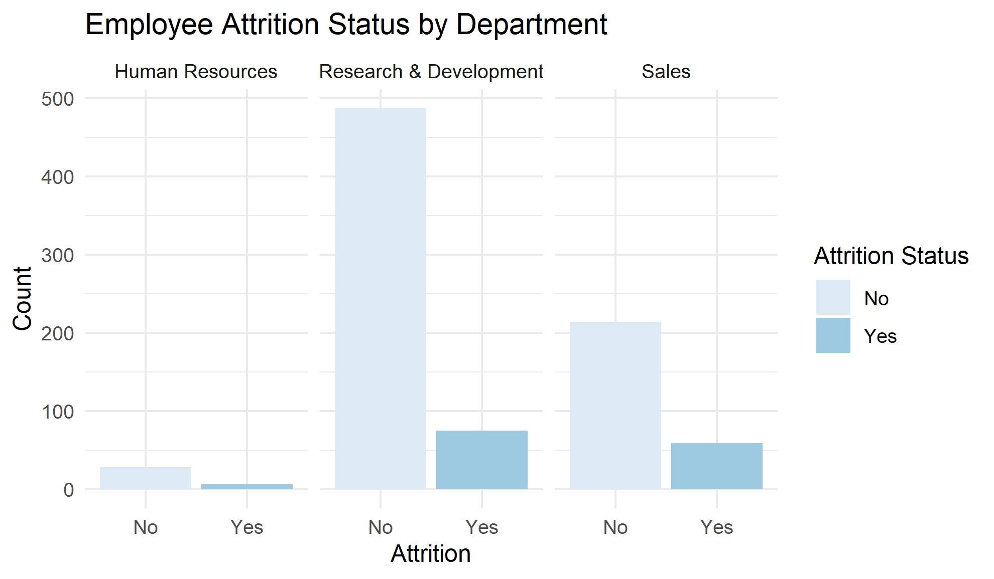
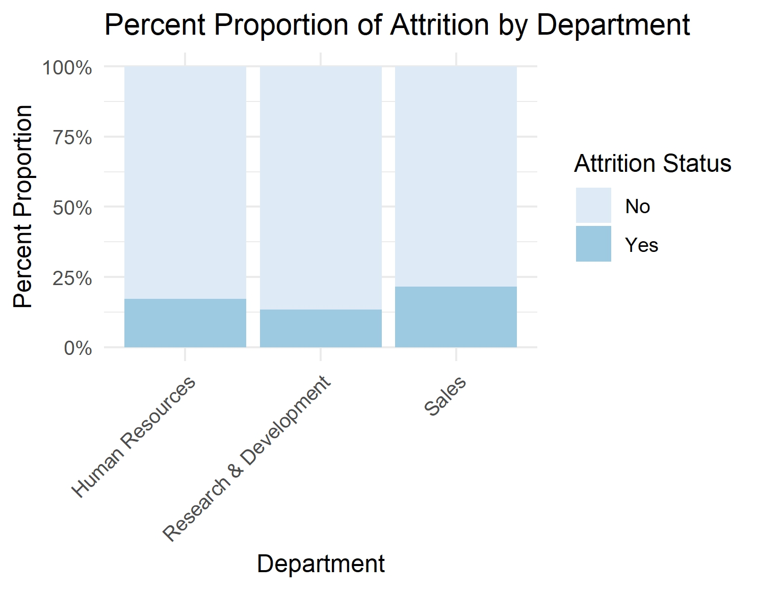
Employee Attrition by Department
No = individuals are currently working at the company
Yes = individuals that left the company
Less than 25% of employees left each department.

Slide 6
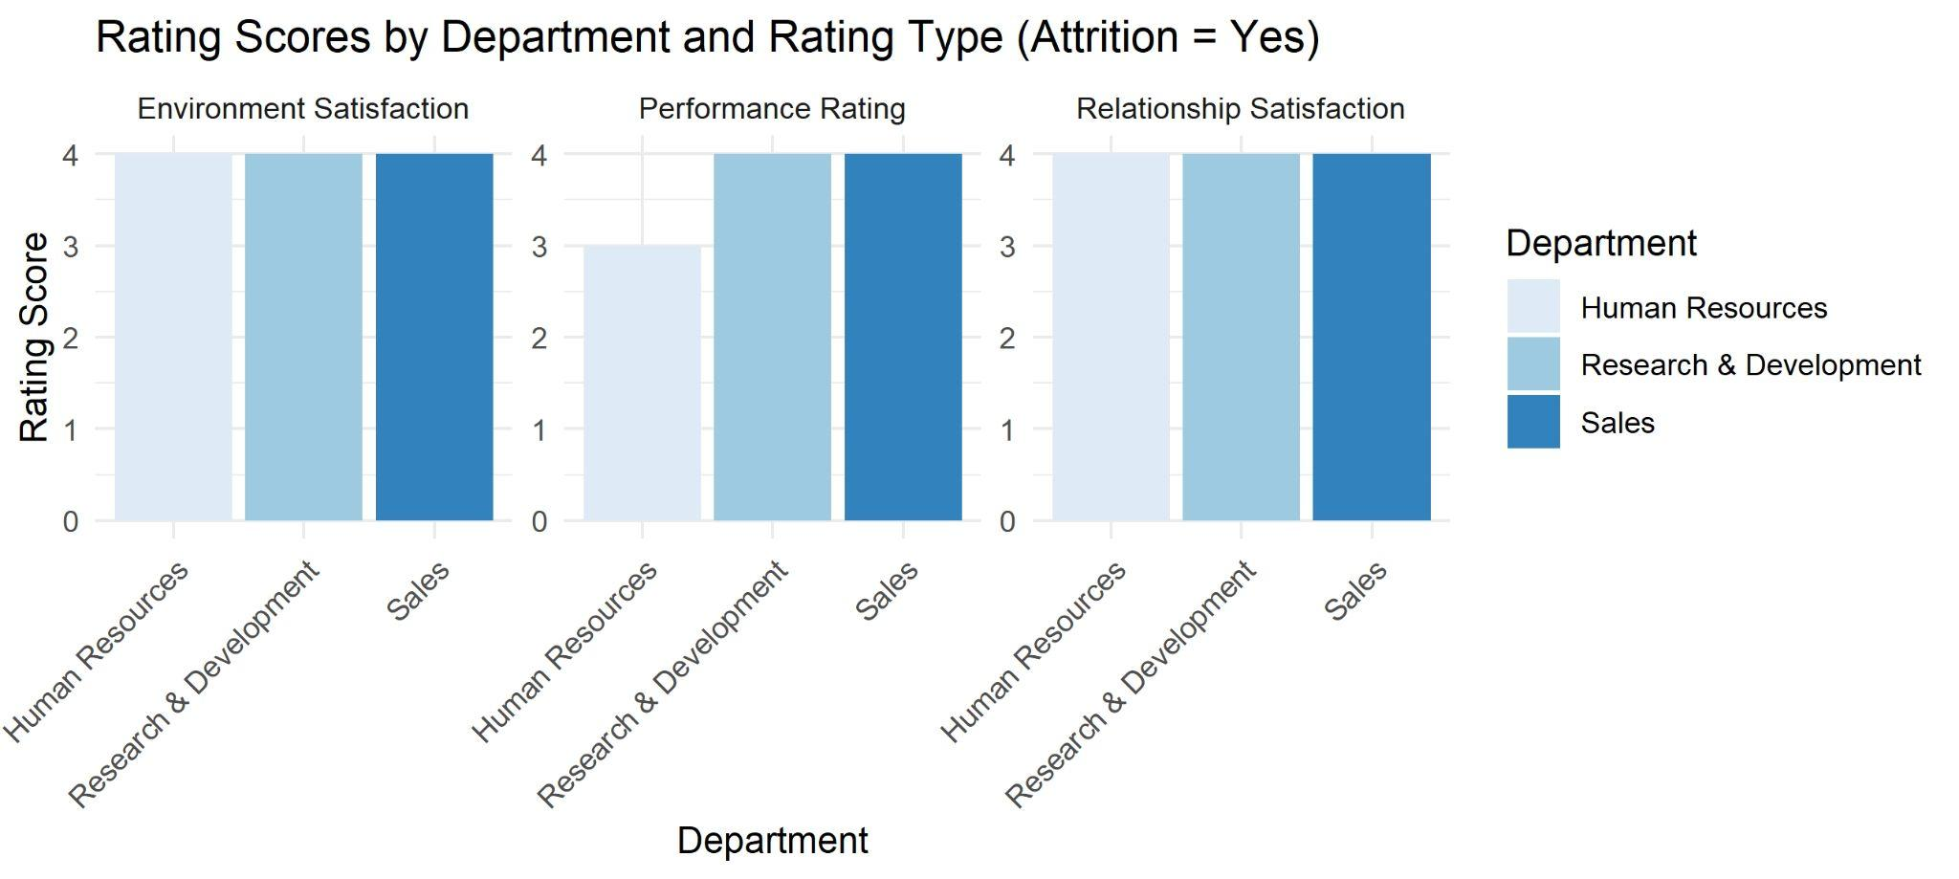
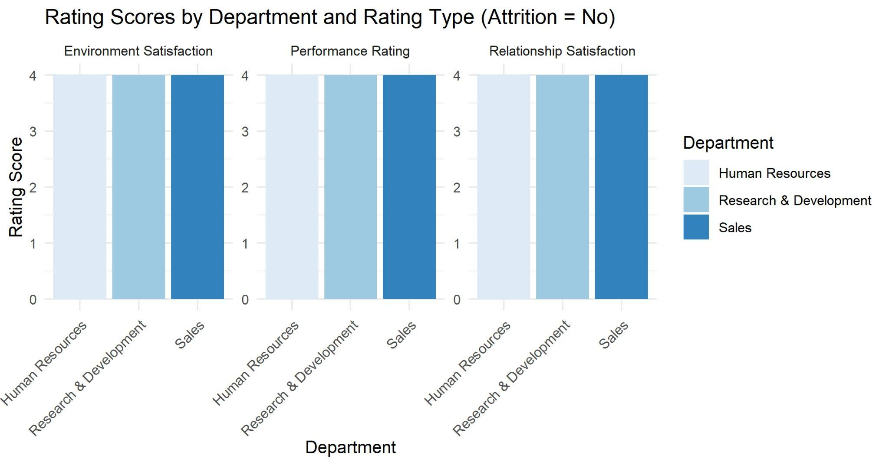
Ratings by Department
High rating scores across all departments, regardless of attrition status.

Slide 7
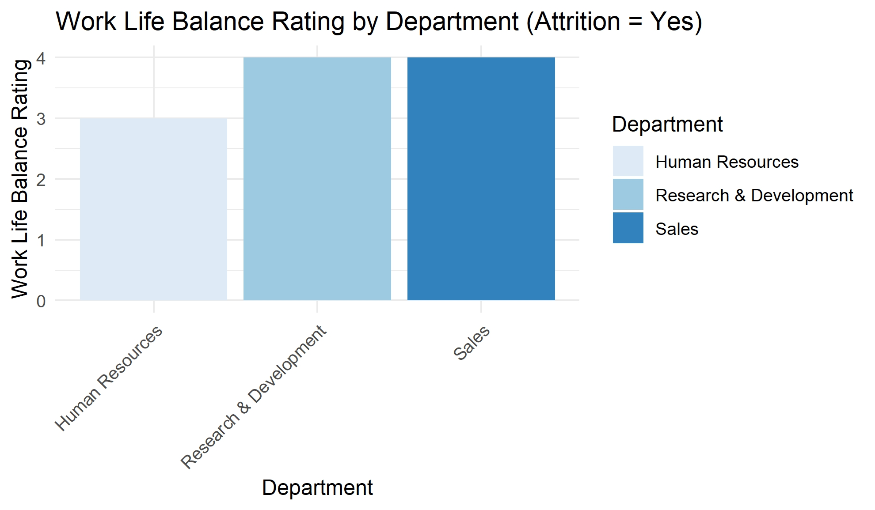
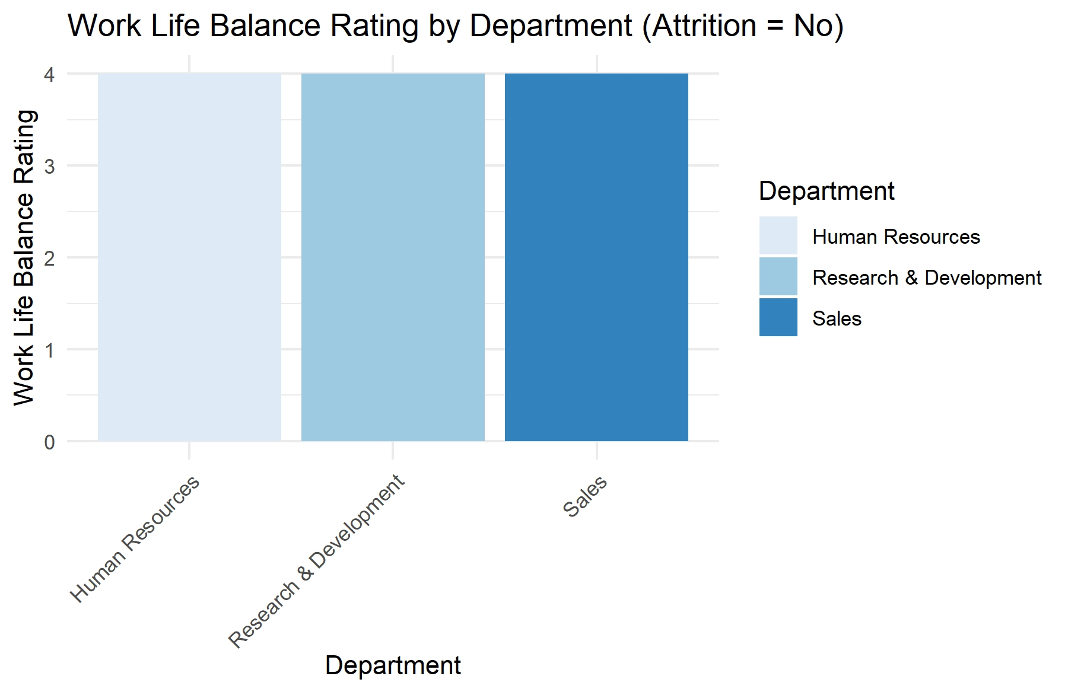
Work Life Balance by Department
High rating scores across all departments, regardless of attrition status.

Slide 8
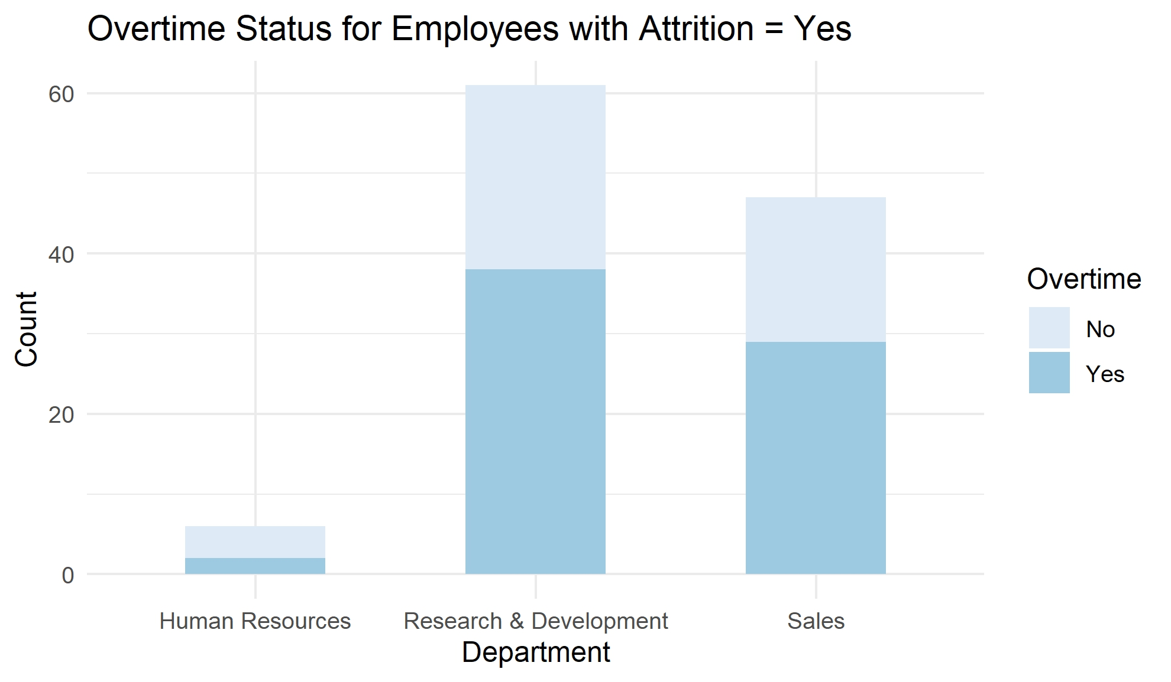
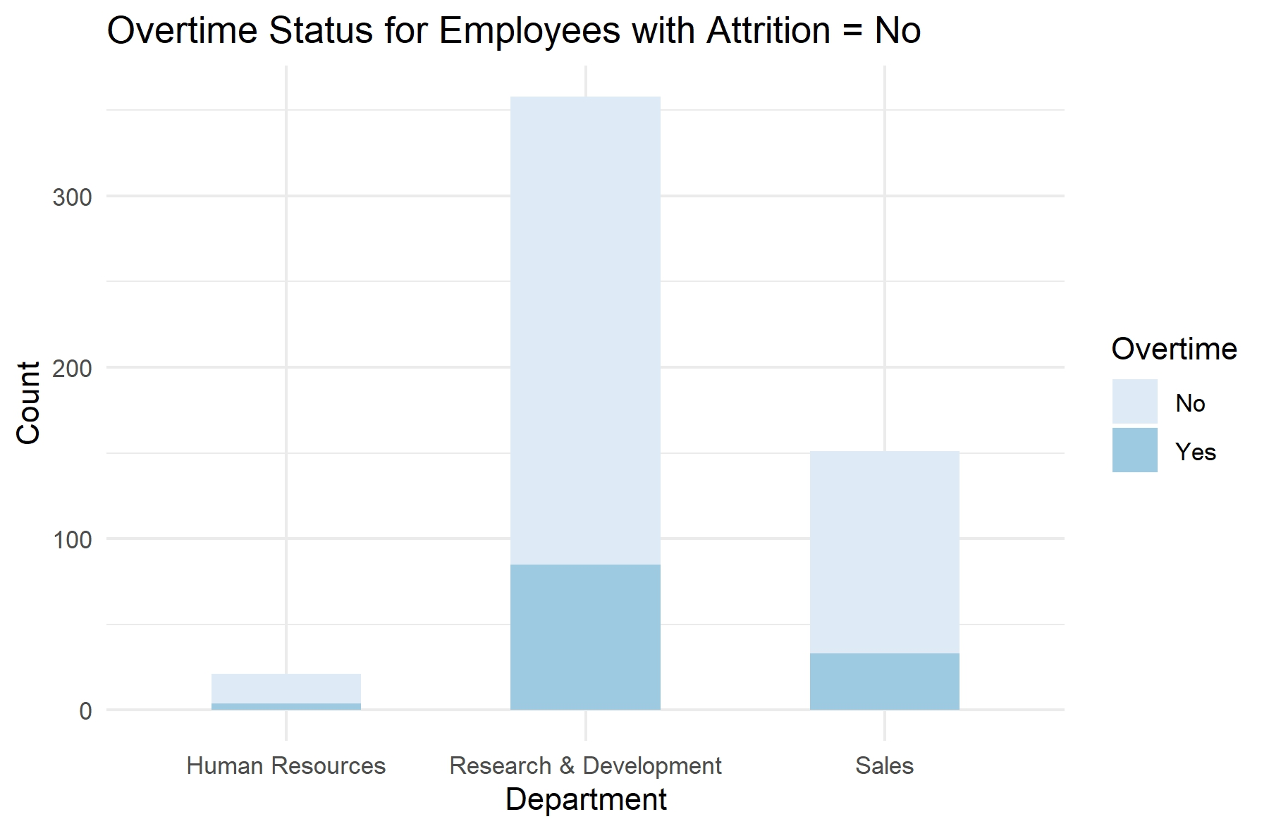
Overtime Status by Department
Majority of employees that left in Research & Development and Sales worked overtime.

Slide 9
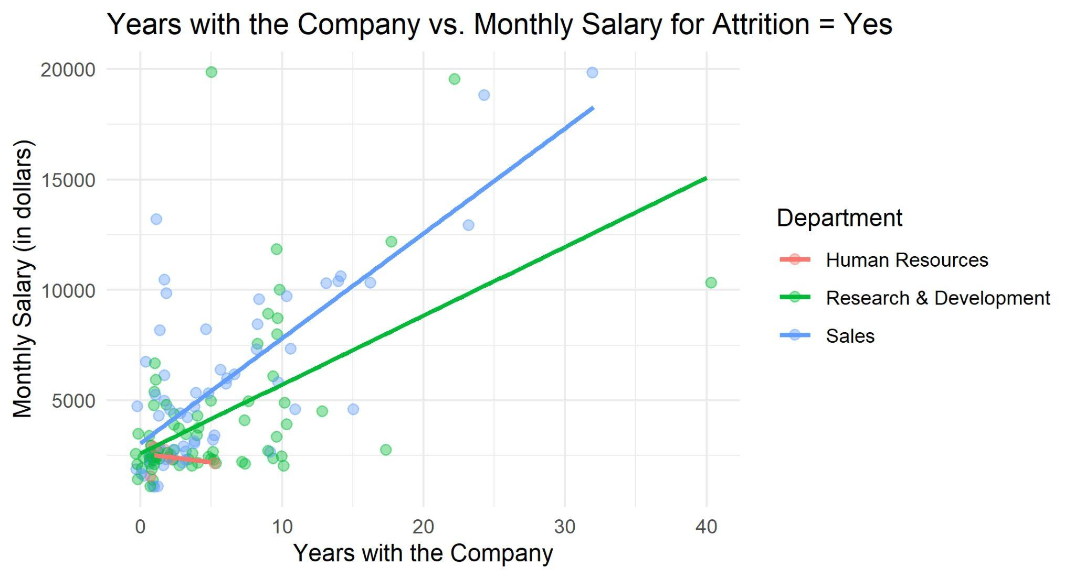
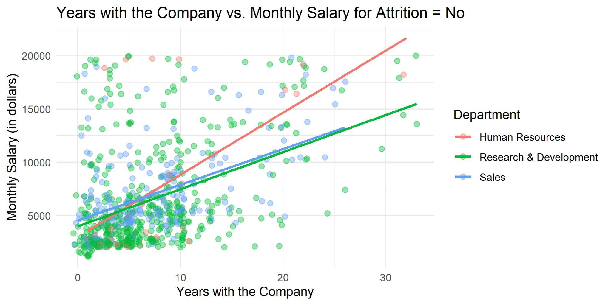
Years with Company vs. Monthly Income
We have a small sample size of employees in Human Resources.
Attrition Yes = Most earned less than $5,000 and worked less than 10 years at company.
Attrition No = Some employees earned more than $5,000 while working less than 10 years at company.

Slide 10
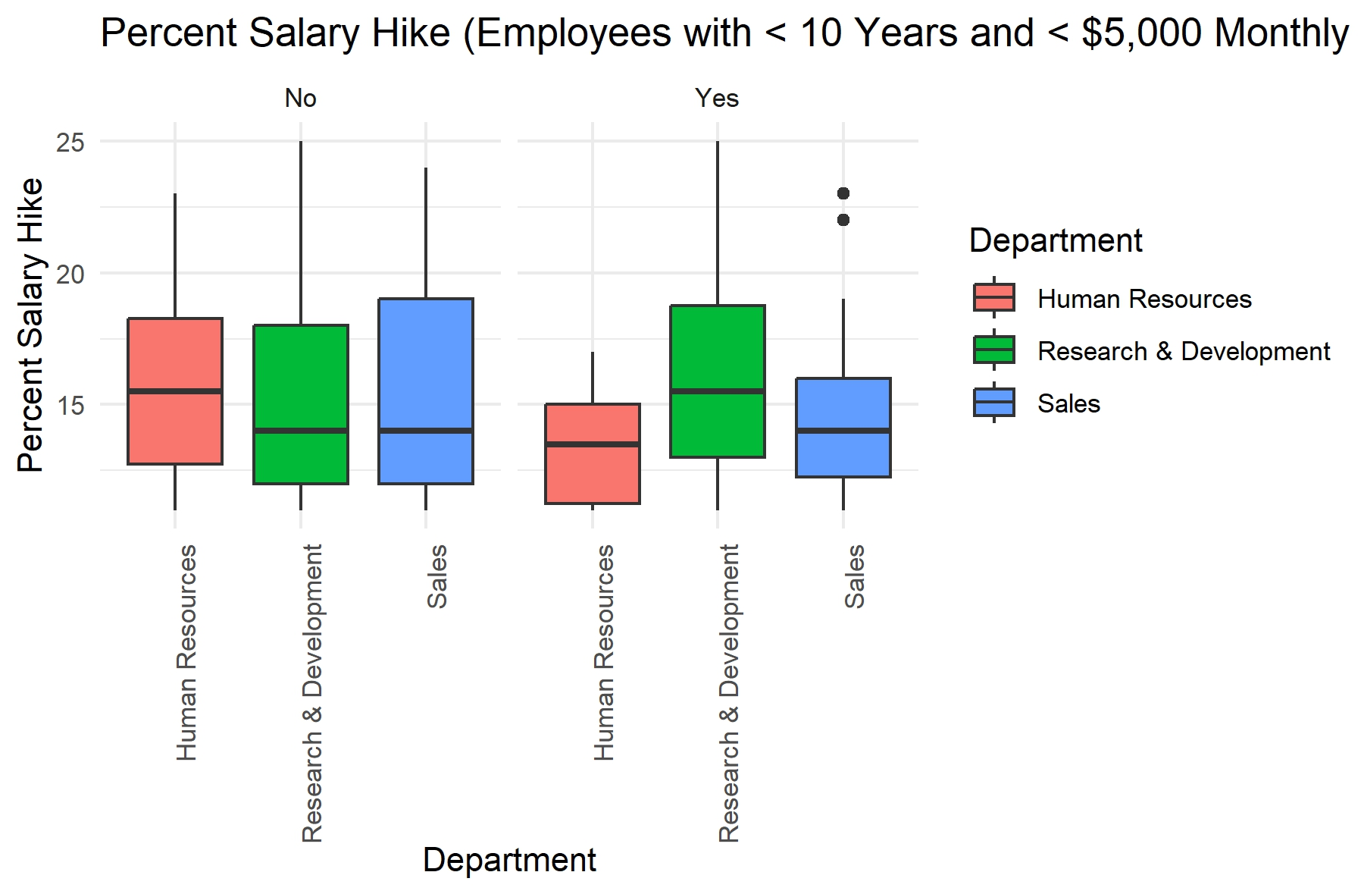
Percent Salary Hike
Employees that left Human Resources and Sales had lower percent salary hikes.

Slide 11
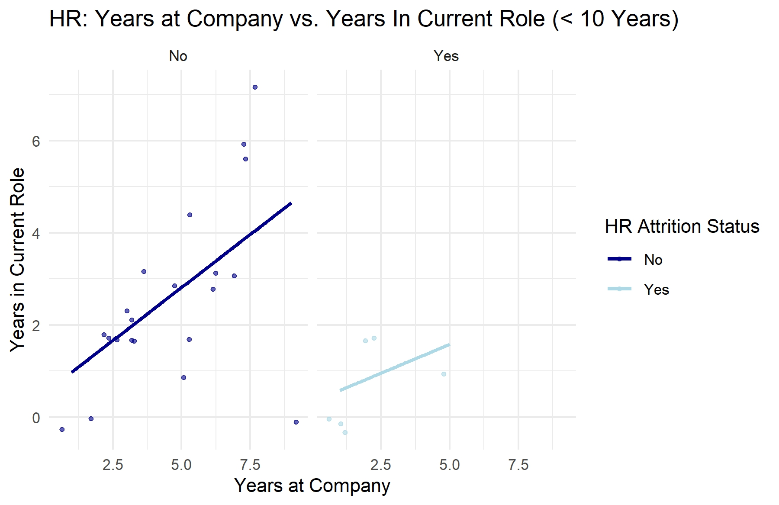
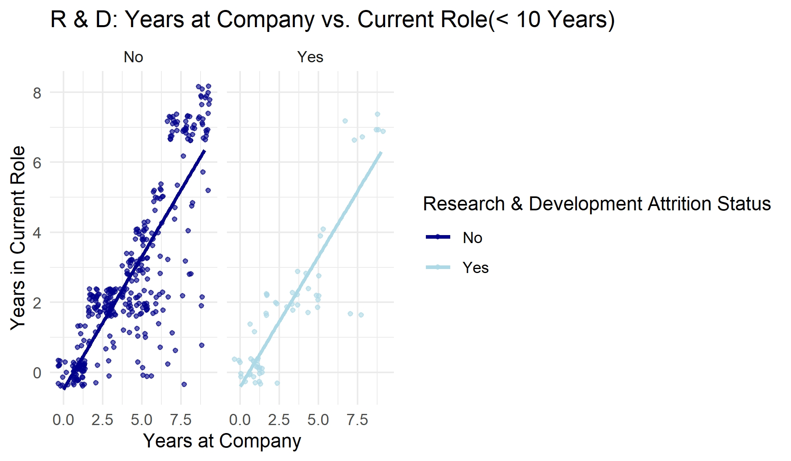
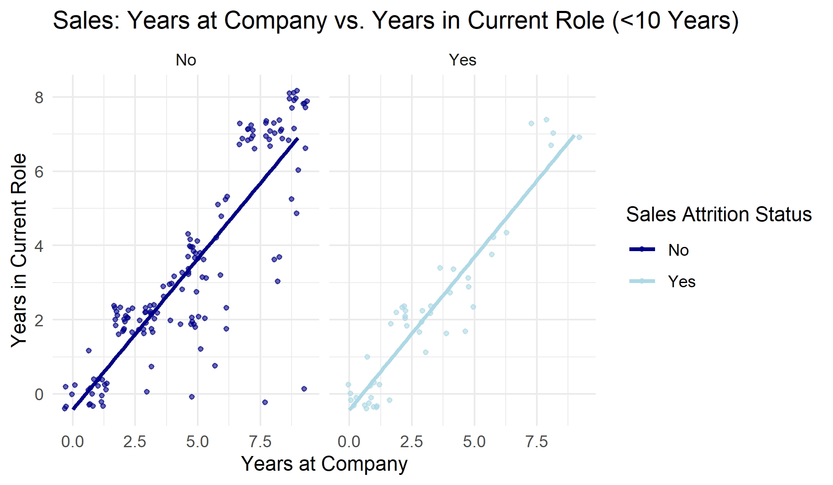
Years at Company vs Years in Current Role
Employees tend to spend a similar duration in their current role as they have overall with the company, indicating minimal role changes.
Most employees in the HR department worked for the company less than 5 years, meaning that there are less veteran employees.

Slide 12
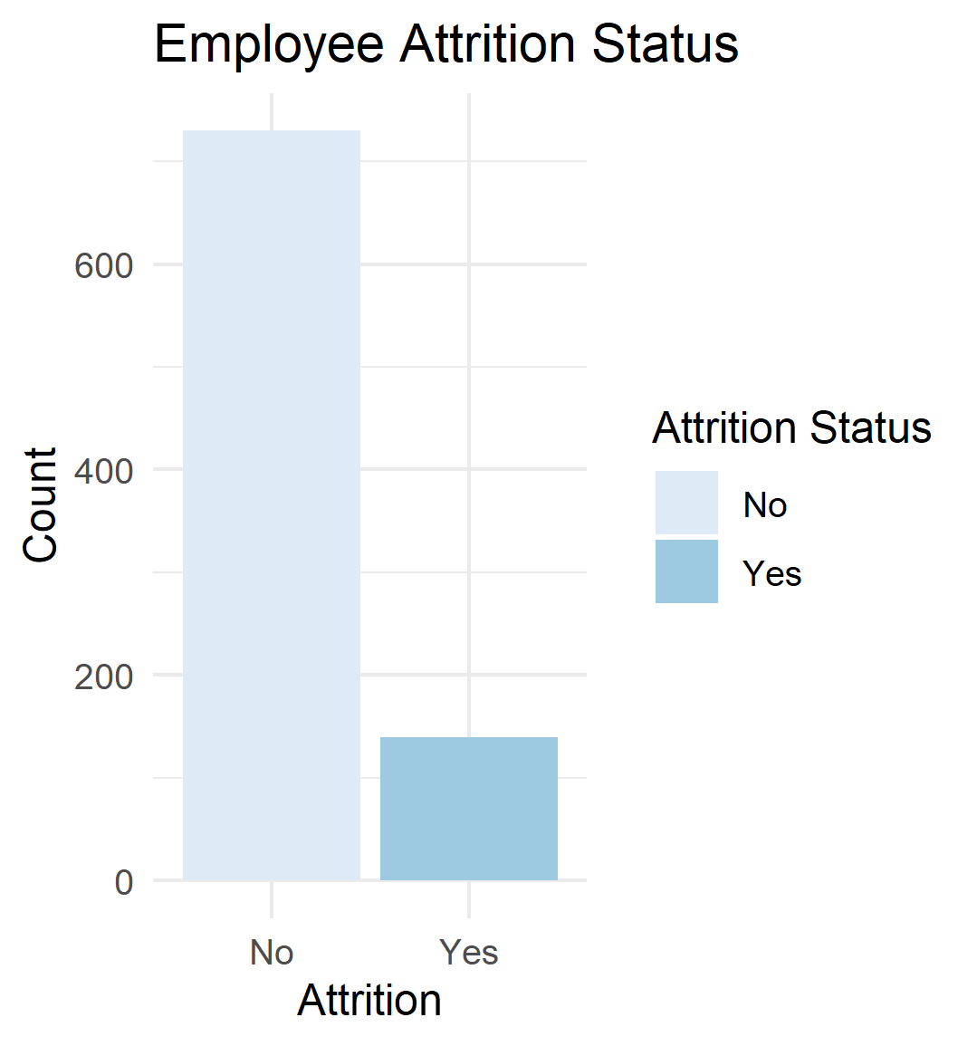
Classification Problem
The goal is to predict whether the employee will leave the company (attrition = yes) based on the following variables:
Monthly Income
Over Time
Percent Salary Hike
Years at Company
The positive class was set to “Yes” for the models.

Slide 13
K-Nearest Neighbors Model
Since there is an unbalanced dataset, adjustments were made to produce the following matrix:
KNN Confusion Matrix and Statistics (261 employees)
Positive Class = “Yes”
 | No (predicted) | Yes (predicted)
No (actual) | 138 (TN) | 16 (FP)
Yes (actual) | 81 (FN) | 26 (TP)
Accuracy = 62.84%
Sensitivity = 61.91%
Specificity = 63.01%
F1 = 35.33%
K = 21
70/30 Split = 609 observed in training set, 261 observed from test set
Undersampling = reduce majority class (attrition = no), improve focus on positive class (attrition = yes)
Threshold (0.50) = moderate, reasonable predictions
Low Precision (24.76%) = overpredicted employees leaving when they are staying
Moderate Recall (57.14%) : Decent prediction of those leaving that are indeed leaving (true positives).

Slide 14
Naïve Bayes Model
Since there is an unbalanced dataset, adjustments were made to produce the following matrix:
NB Confusion Matrix and Statistics (261 employees)
Positive Class = “Yes”
 | No (predicted) | Yes (predicted)
No (actual) | 133 (TN) | 13 (FP)
Yes (actual) | 82 (FN) | 33 (TP)
Accuracy = 63.60%
Sensitivity = 71.74%
Specificity = 61.86%
F1 = 35.40%
70/30 Split = 609 observed in training set, 261 observed from test set
Undersampling = reduce majority class (attrition = no), improve focus on positive class (attrition = yes)
Threshold (0.60) = moderate, reasonable predictions
Low Precision (24.81%) = overpredicted employees leaving when they are staying

Slide 15
Summary
Each department had less than 25% of employees leaving the company.
Satisfaction, performance, and work life balance ratings showed little significant to attrition.
Majority of employees that left Sales and Research & Development worked overtime.
Most of the employees that left each department worked the same amount of years in their job role.
Naïve Bayes Model was able to make better predictions.
Low precision suggest that employees expected to leave are actually staying.

Slide 16
Questions?

Slide 17
Contact
Megan Huy, MSDS Student at Southern Methodist University
email: mhuy@mail.smu.edu

